Slide 1

Basics of
Web Design
Copyright © 2016 Pearson Education, Inc., Hoboken NJ

Slide 2
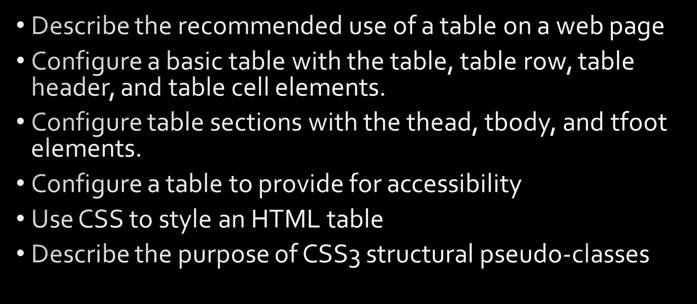
Learning Outcomes
Copyright © 2016 Pearson Education, Inc., Hoboken NJ

Slide 3
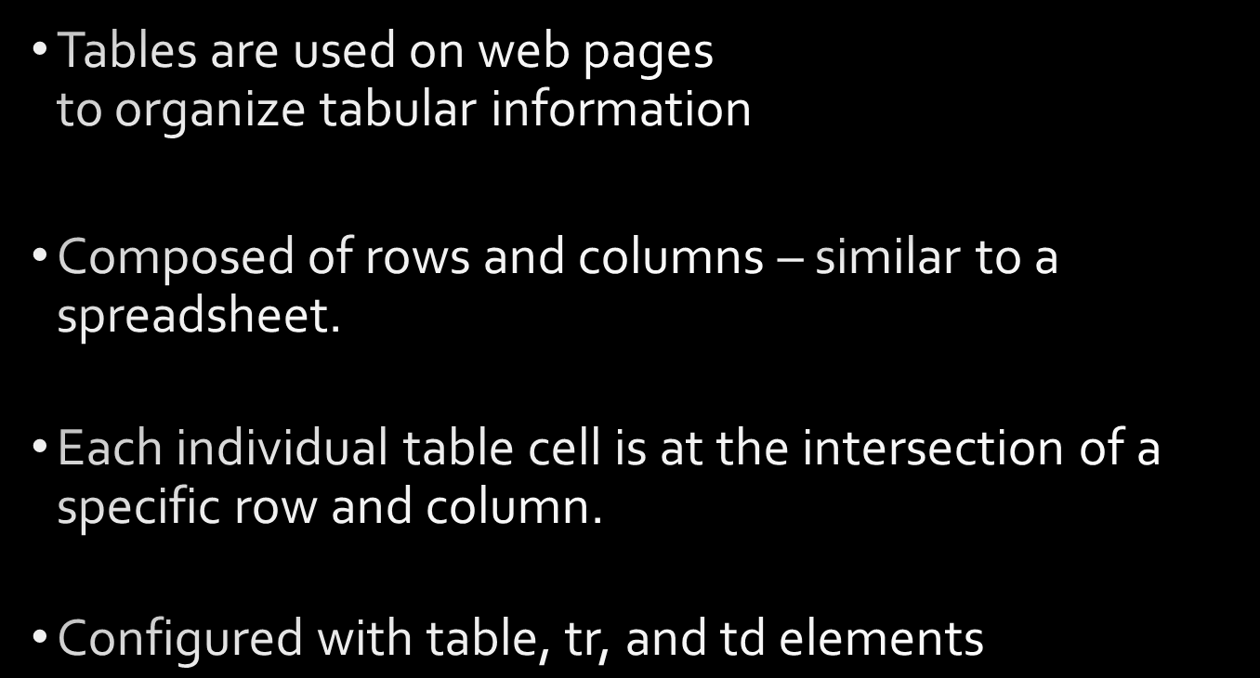
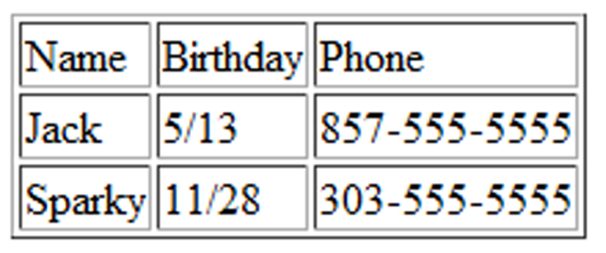
HTML Table
Copyright © 2016 Pearson Education, Inc., Hoboken NJ

Slide 4
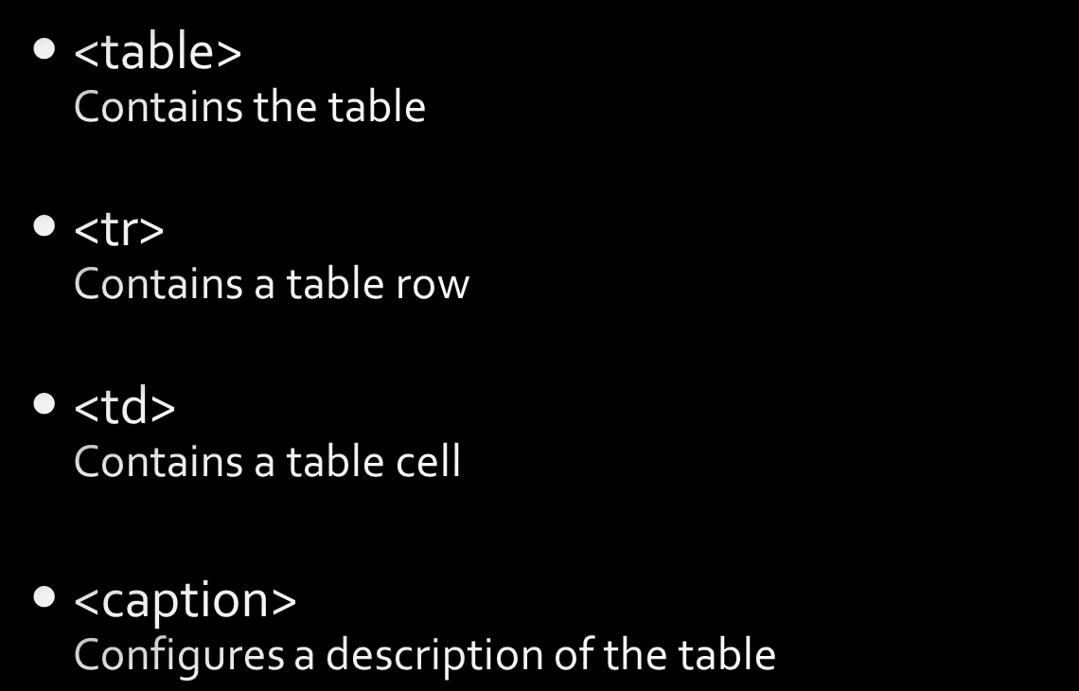
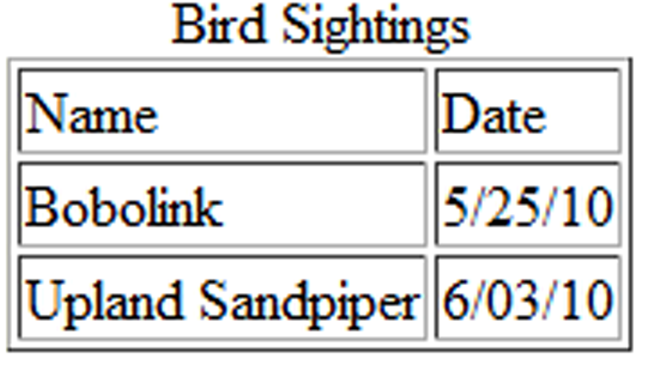
HTML Table Elements
Copyright © 2016 Pearson Education, Inc., Hoboken NJ

Slide 5

The Table Element
<table>
Copyright © 2016 Pearson Education, Inc., Hoboken NJ

Slide 6

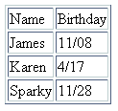
HTML
Table Example
Birthday List
Copyright © 2016 Pearson Education, Inc., Hoboken NJ

Slide 7

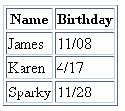
HTML
Table Example 2
Using the <th> Element
Copyright © 2016 Pearson Education, Inc., Hoboken NJ

Slide 8


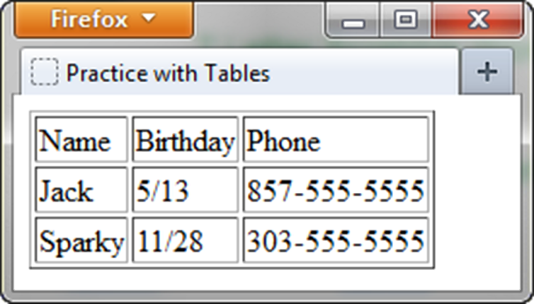
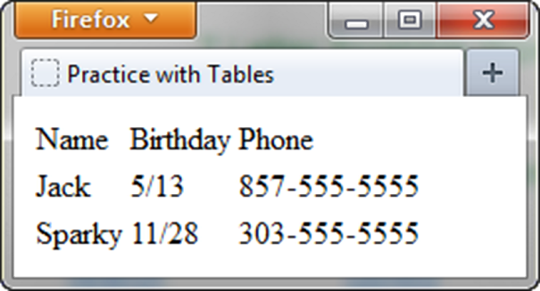
Copyright © 2016 Pearson Education, Inc., Hoboken NJ

Slide 9
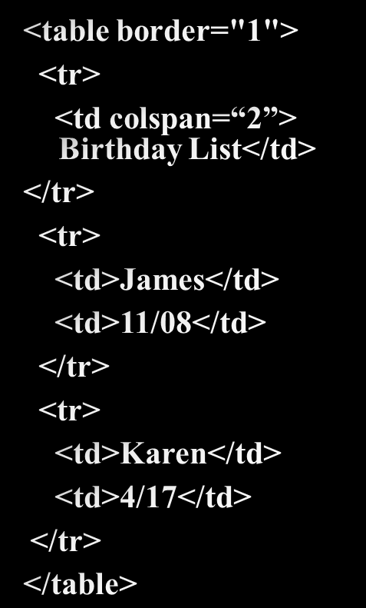

HTML colspan Attribute
Copyright © 2016 Pearson Education, Inc., Hoboken NJ

Slide 10
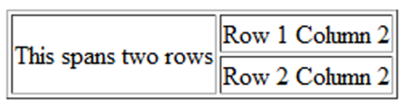
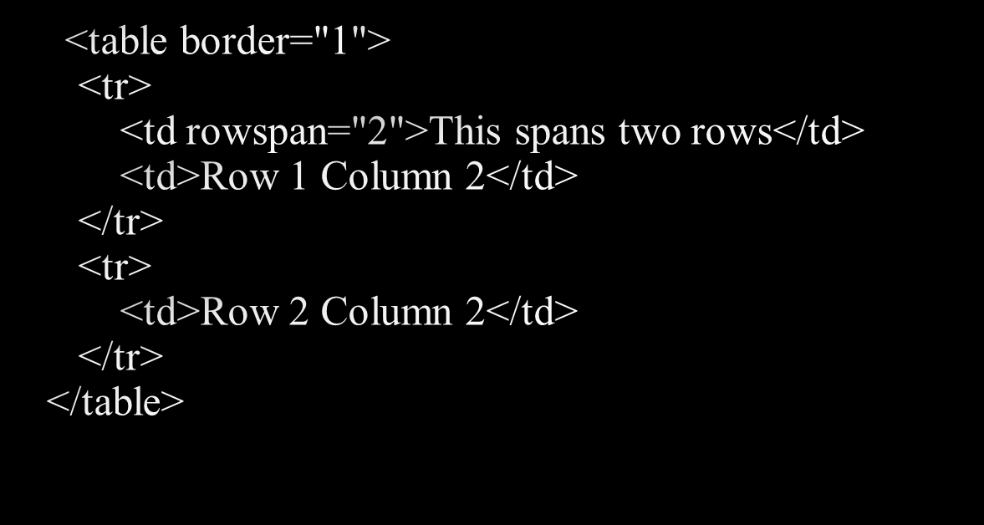
HTML rowspan
Attribute
Copyright © 2016 Pearson Education, Inc., Hoboken NJ

Slide 11
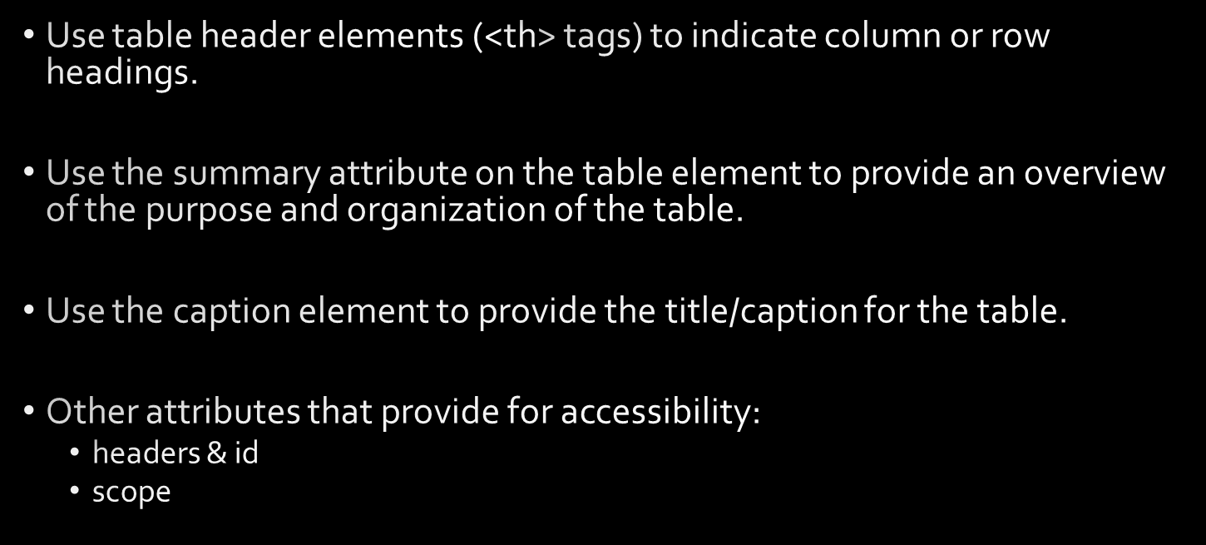

Accessibility and Tables
Copyright © 2016 Pearson Education, Inc., Hoboken NJ

Slide 12
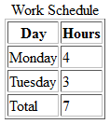

Accessibility: headers & id Attributes
<table>
<caption> Word Schedule</caption>
<tr>
<th id="day">Day</th>
<th id="hours">Hours</th>
</tr>
<tr>
<td headers="day">Monday</td>
<td headers="hours">4</td>
</tr>
<tr>
<td headers="day">Tuesday</td>
<td headers="hours">3</td>
</tr>
<tr>
<td headers="day">Total</td>
<td headers="hours">7</td>
</tr>
</table>
Copyright © 2016 Pearson Education, Inc., Hoboken NJ

Slide 13

Using CSS to Style a Table
HTML Attribute | CSS Property
align | Align a table: table { width: 75%; margin: auto; } Align within a table cell: text-align
bgcolor | background-color
cellpadding | padding
cellspacing | border-spacing or border-collapse
height | height
valign | vertical-align
width | width
border | border, border-style, or border-spacing
--- | background-image
--- | caption-side
Copyright © 2016 Pearson Education, Inc., Hoboken NJ

Slide 14

Pseudo-class | Purpose
:first-of-type | Applies to the first element of the specified type.
:first-child | Applies to the first child of an element. (CSS2 selector)
:last-of-type | Applies to the last element of the specified type.
:last-child | Applies to the last child of an element
:nth-of-type(n) | Applies to the “nth” element of the specified type. Values: a number, odd, or even
Copyright © 2016 Pearson Education, Inc., Hoboken NJ

Slide 15
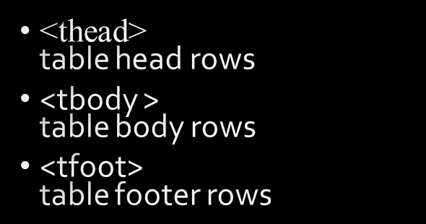

Table Row
Groups
<table>
<caption>Work Schedule</caption>
<thead>
<tr>
<th>Day</th>
<th>Hours</th>
</tr>
</thead>
<tbody>
<tr>
<td>Monday</td>
<td>4</td>
</tr>
<tr>
<td>Tuesday</td>
<td>3</td>
</tr>
</tbody>
<tfoot>
<tr>
<td>Total</td>
<td>7</td>
</tr>
</tfoot>
</table>
Copyright © 2016 Pearson Education, Inc., Hoboken NJ

Slide 16
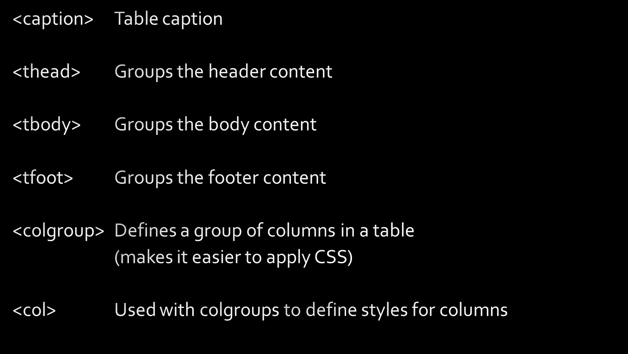
Tables - additional tags

Slide 17
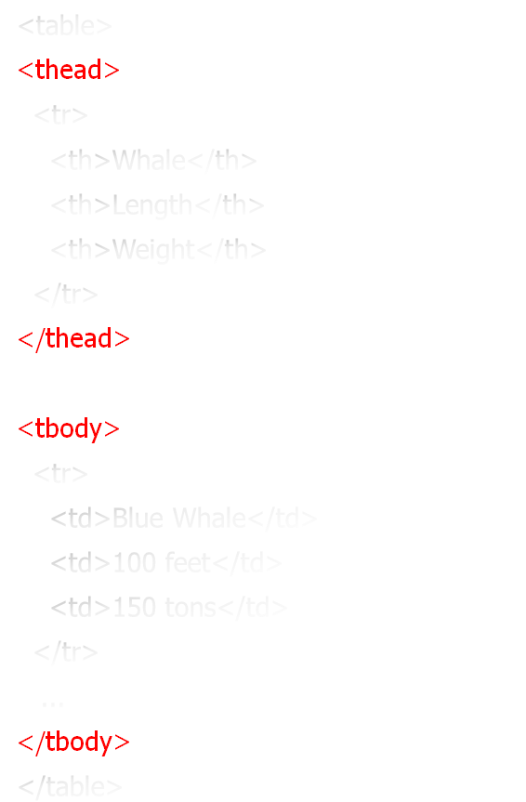
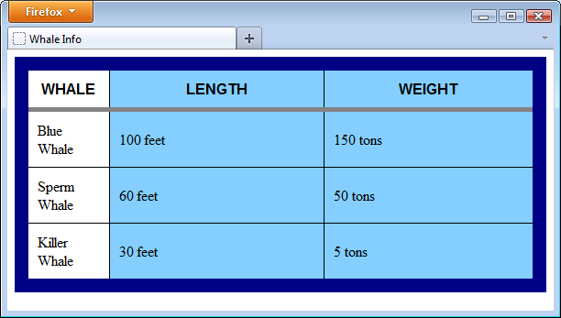
Tables - add'l context tags
<style>
table {
border: 15px solid navy;
border-collapse: collapse;
}
th, td {
border: 1px solid black;
padding:10px;
}
thead {
font-family:sans-serif, arial;
text-transform:uppercase;
border:5px solid gray
}
</style>

Slide 18
Tables - colgroup
<style>
.whaleinfo {background-color:LightSkyBlue; width: 300px}
.whale {width:100px}
...
</style>
<table>
<colgroup>
<col class="whale"></col>
<col class="whaleinfo"></col>
<col class="whaleinfo"></col>
<colgroup>
...

Slide 19

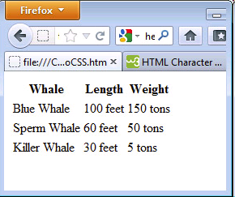
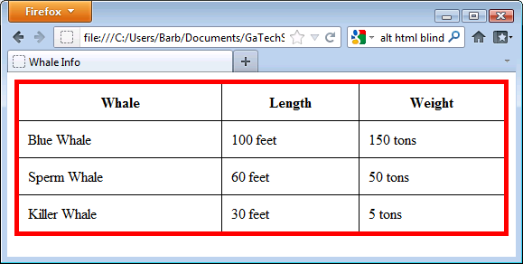
with No CSS Styling
with CSS Styling

Slide 20

Summary
Copyright © 2016 Pearson Education, Inc., Hoboken NJ

